Slide 1

MODERN OPERATING SYSTEMS
Third Edition
ANDREW S. TANENBAUM
Chapter 2
Processes and Threads
Tanenbaum, Modern Operating Systems 3 e, (c) 2008 Prentice-Hall, Inc. All rights reserved. 0-13-6006639

Slide 2

The Process Model
Figure 2-1. (a) Multiprogramming of four programs. (b) Conceptual model of four independent, sequential processes. (c) Only one program is active at once.
Tanenbaum, Modern Operating Systems 3 e, (c) 2008 Prentice-Hall, Inc. All rights reserved. 0-13-6006639

Slide 3
Process Creation
Events which cause process creation:
System initialization.
Execution of a process creation system call by a running process.
A user request to create a new process.
Initiation of a batch job.
Tanenbaum, Modern Operating Systems 3 e, (c) 2008 Prentice-Hall, Inc. All rights reserved. 0-13-6006639

Slide 4
Process Termination
Events which cause process termination:
Normal exit (voluntary).
Error exit (voluntary).
Fatal error (involuntary).
Killed by another process (involuntary).
Tanenbaum, Modern Operating Systems 3 e, (c) 2008 Prentice-Hall, Inc. All rights reserved. 0-13-6006639

Slide 5
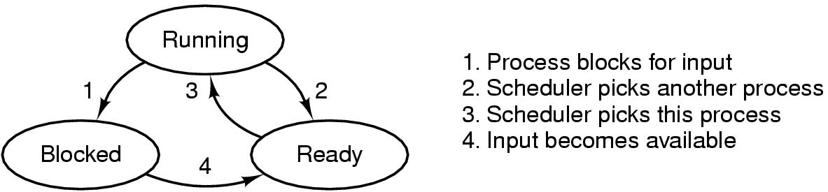
Process States
Figure 2-2. A process can be in running, blocked, or ready state. Transitions between these states are as shown.
Tanenbaum, Modern Operating Systems 3 e, (c) 2008 Prentice-Hall, Inc. All rights reserved. 0-13-6006639

Slide 6
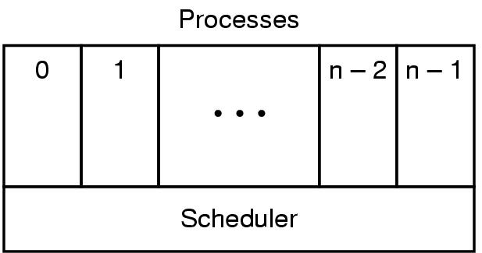
Implementation of Processes (1)
Figure 2-3. The lowest layer of a process-structured operating system handles interrupts and scheduling. Above that layer are sequential processes.
Tanenbaum, Modern Operating Systems 3 e, (c) 2008 Prentice-Hall, Inc. All rights reserved. 0-13-6006639

Slide 7
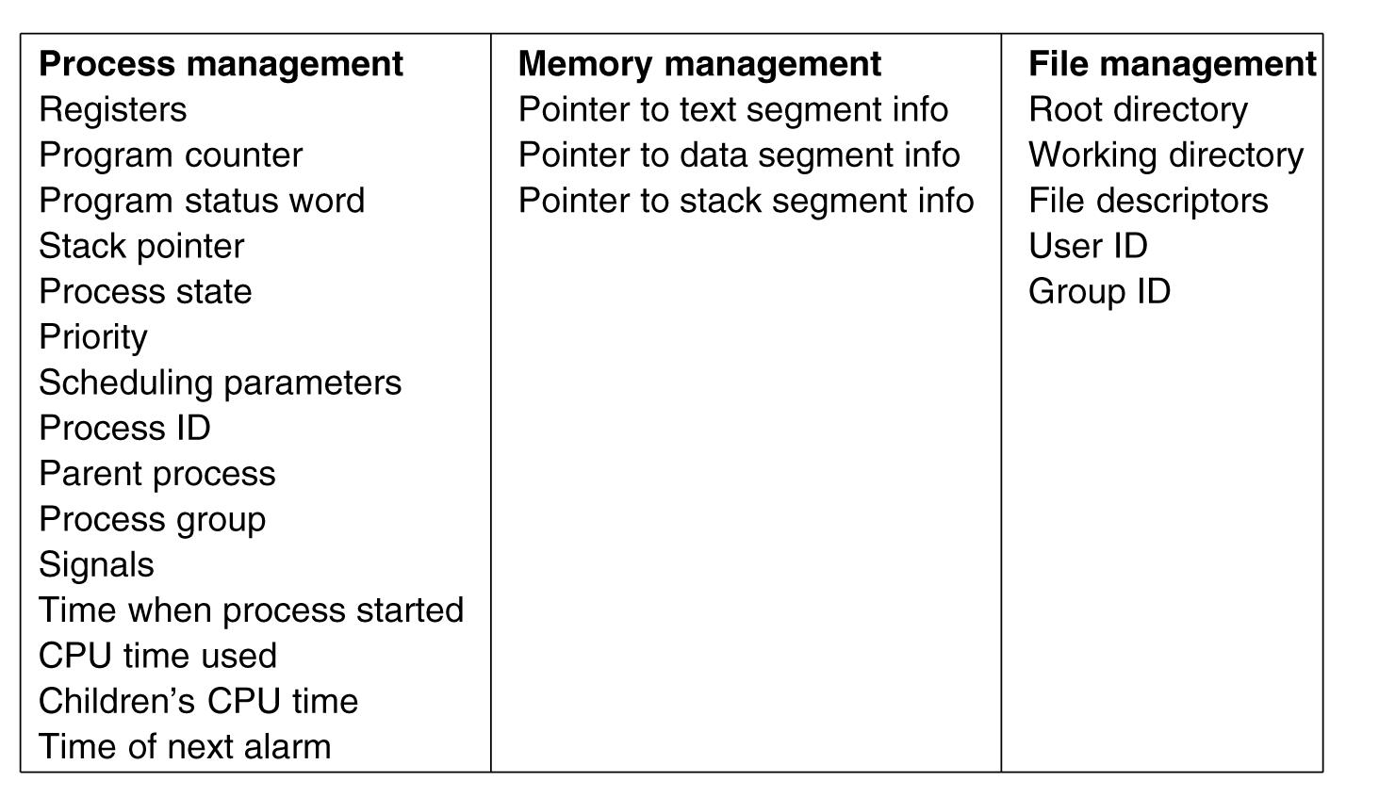
Implementation of Processes (2)
Figure 2-4. Some of the fields of a typical process table entry.
Tanenbaum, Modern Operating Systems 3 e, (c) 2008 Prentice-Hall, Inc. All rights reserved. 0-13-6006639

Slide 8
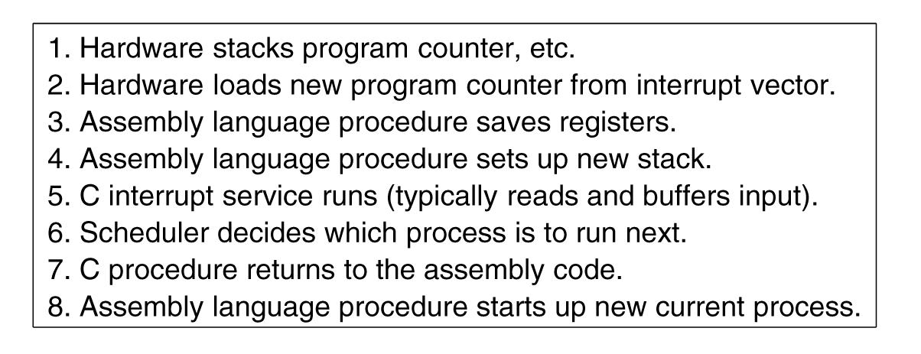
Implementation of Processes (3)
Figure 2-5. Skeleton of what the lowest level of the operating system does when an interrupt occurs.
Tanenbaum, Modern Operating Systems 3 e, (c) 2008 Prentice-Hall, Inc. All rights reserved. 0-13-6006639

Slide 9
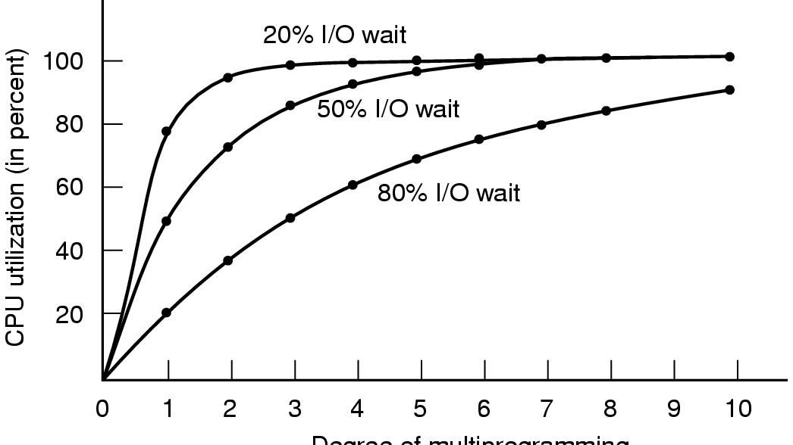
Modeling Multiprogramming
Figure 2-6. CPU utilization as a function of the number of processes in memory.
Tanenbaum, Modern Operating Systems 3 e, (c) 2008 Prentice-Hall, Inc. All rights reserved. 0-13-6006639

Slide 10

Thread Usage (1)
Figure 2-7. A word processor with three threads.
Tanenbaum, Modern Operating Systems 3 e, (c) 2008 Prentice-Hall, Inc. All rights reserved. 0-13-6006639

Slide 11

Thread Usage (2)
Figure 2-8. A multithreaded Web server.
Tanenbaum, Modern Operating Systems 3 e, (c) 2008 Prentice-Hall, Inc. All rights reserved. 0-13-6006639

Slide 12
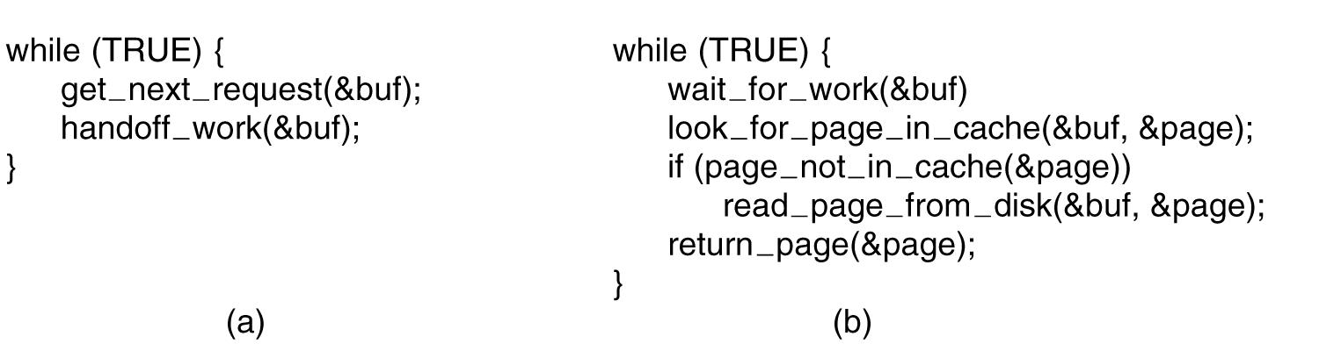
Thread Usage (3)
Figure 2-9. A rough outline of the code for Fig. 2-8. (a) Dispatcher thread. (b) Worker thread.
Tanenbaum, Modern Operating Systems 3 e, (c) 2008 Prentice-Hall, Inc. All rights reserved. 0-13-6006639

Slide 13
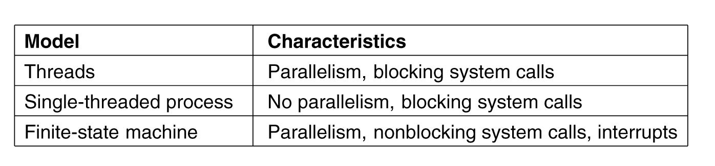
Thread Usage (4)
Figure 2-10. Three ways to construct a server.
Tanenbaum, Modern Operating Systems 3 e, (c) 2008 Prentice-Hall, Inc. All rights reserved. 0-13-6006639

Slide 14

The Classical Thread Model (1)
Figure 2-11. (a) Three processes each with one thread. (b) One process with three threads.
Tanenbaum, Modern Operating Systems 3 e, (c) 2008 Prentice-Hall, Inc. All rights reserved. 0-13-6006639

Slide 15
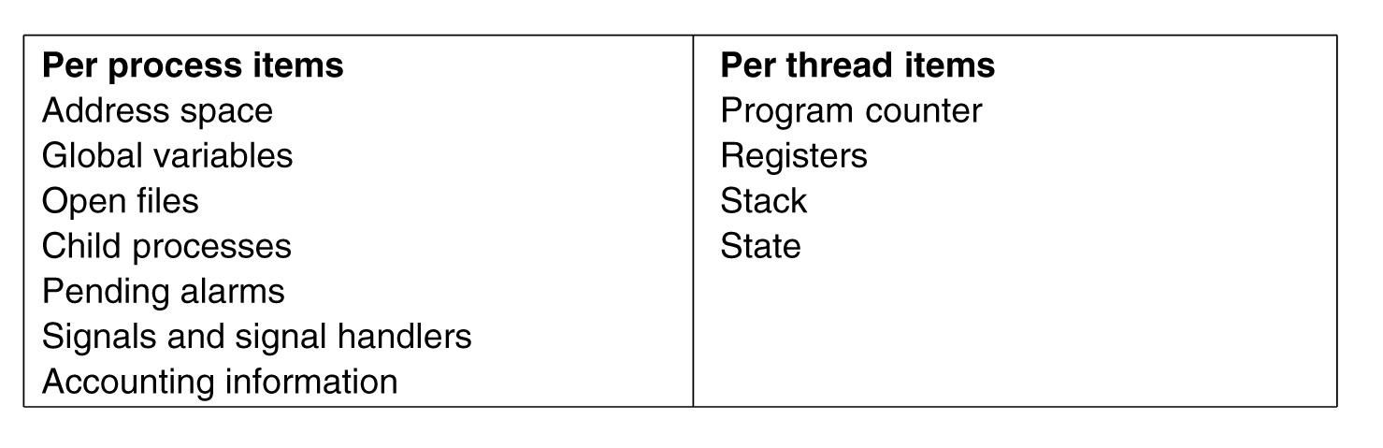
The Classical Thread Model (2)
Figure 2-12. The first column lists some items shared by all threads in a process. The second one lists some items private to each thread.
Tanenbaum, Modern Operating Systems 3 e, (c) 2008 Prentice-Hall, Inc. All rights reserved. 0-13-6006639

Slide 16

The Classical Thread Model (3)
Figure 2-13. Each thread has its own stack.
Tanenbaum, Modern Operating Systems 3 e, (c) 2008 Prentice-Hall, Inc. All rights reserved. 0-13-6006639

Slide 17
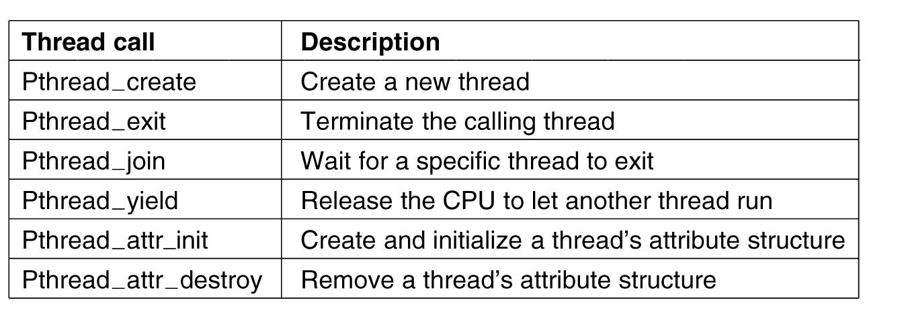
POSIX Threads (1)
Figure 2-14. Some of the Pthreads function calls.
Tanenbaum, Modern Operating Systems 3 e, (c) 2008 Prentice-Hall, Inc. All rights reserved. 0-13-6006639

Slide 18
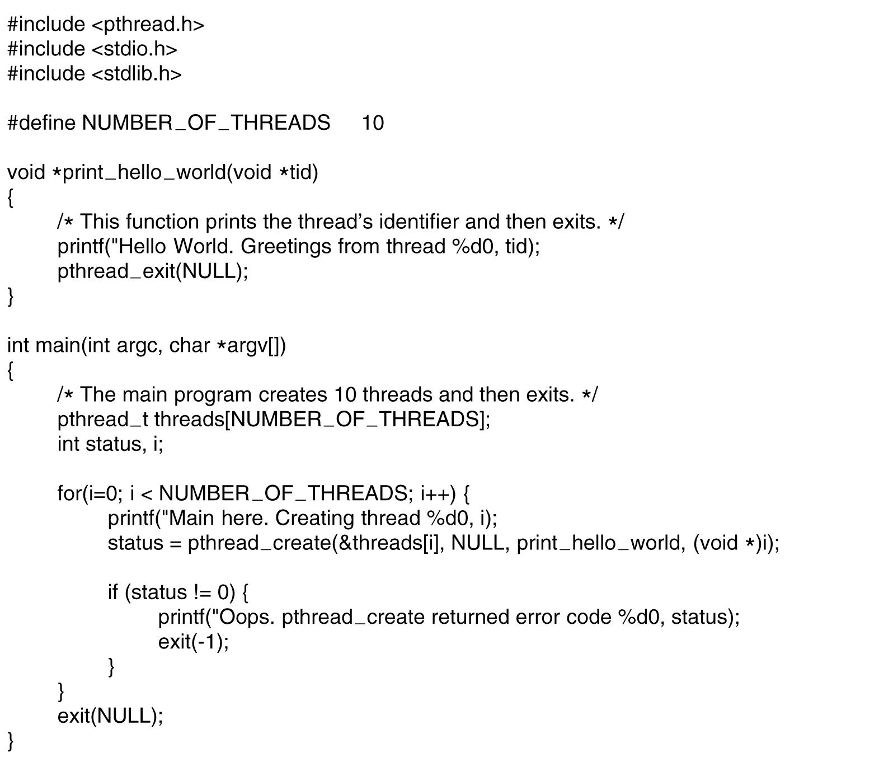
POSIX Threads (2)
. . .
Figure 2-15. An example program using threads.
Tanenbaum, Modern Operating Systems 3 e, (c) 2008 Prentice-Hall, Inc. All rights reserved. 0-13-6006639

Slide 19
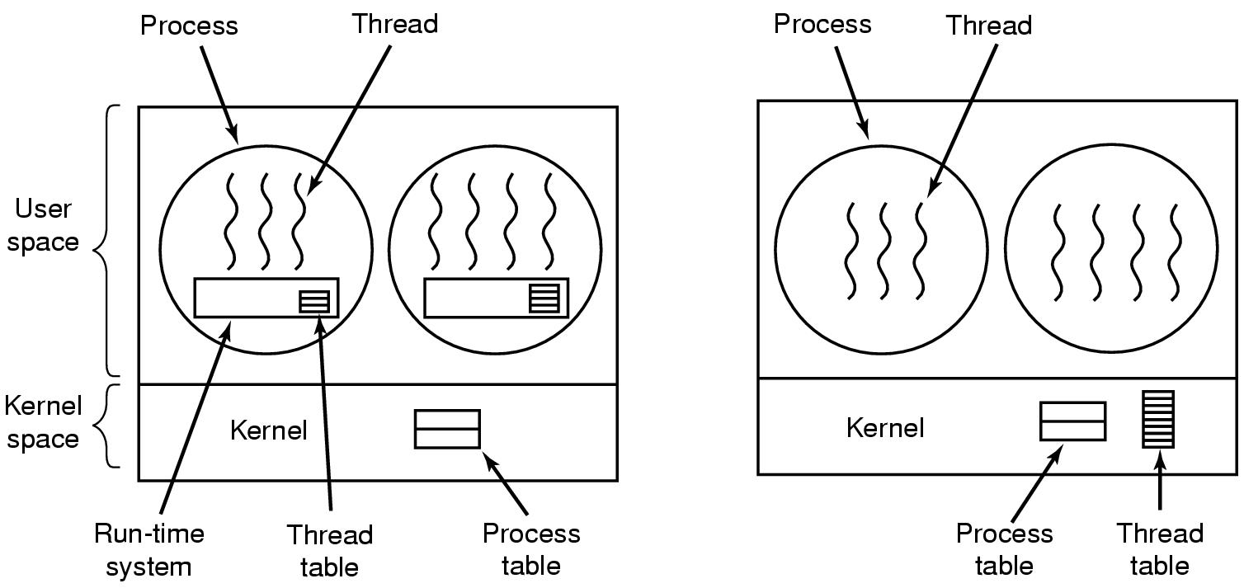
Implementing Threads in User Space
Figure 2-16. (a) A user-level threads package. (b) A threads package managed by the kernel.
Tanenbaum, Modern Operating Systems 3 e, (c) 2008 Prentice-Hall, Inc. All rights reserved. 0-13-6006639

Slide 20
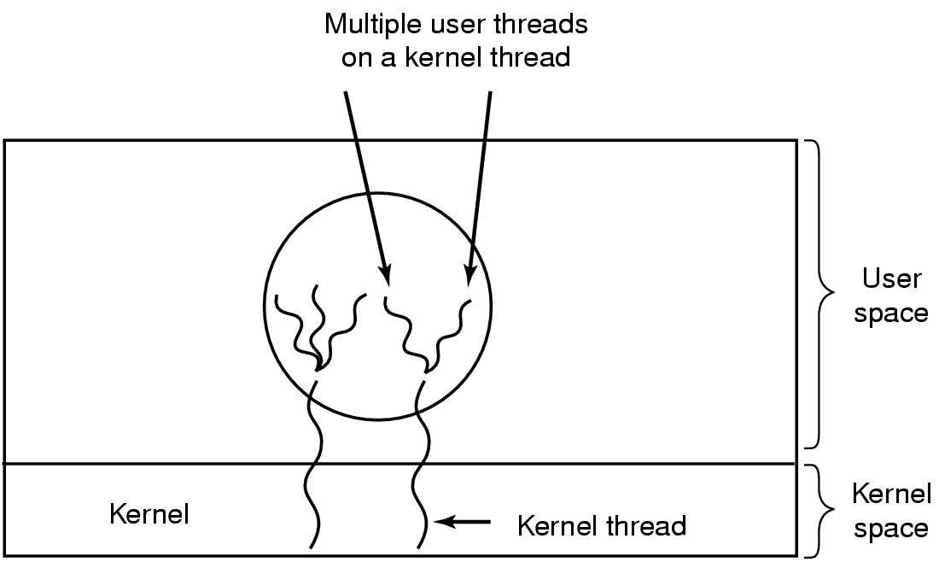
Hybrid Implementations
Figure 2-17. Multiplexing user-level threads
onto kernel-level threads.
Tanenbaum, Modern Operating Systems 3 e, (c) 2008 Prentice-Hall, Inc. All rights reserved. 0-13-6006639

Slide 21
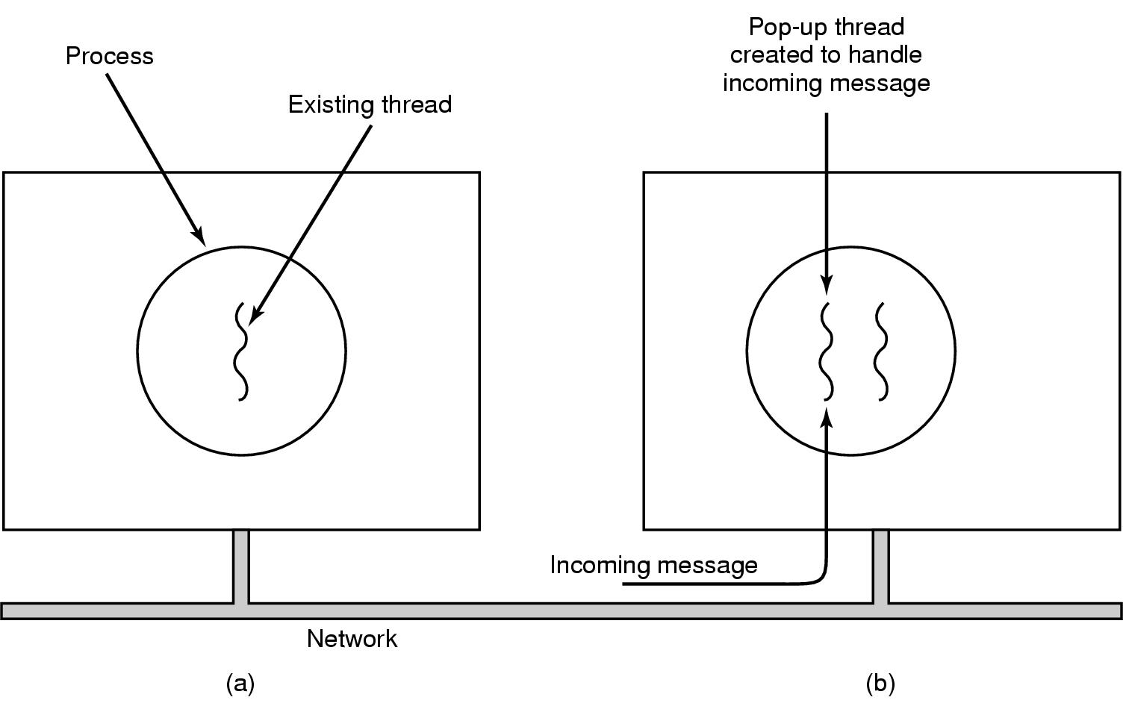
Pop-Up Threads
Figure 2-18. Creation of a new thread when a message arrives. (a) Before the message arrives.
(b) After the message arrives.
Tanenbaum, Modern Operating Systems 3 e, (c) 2008 Prentice-Hall, Inc. All rights reserved. 0-13-6006639

Slide 22
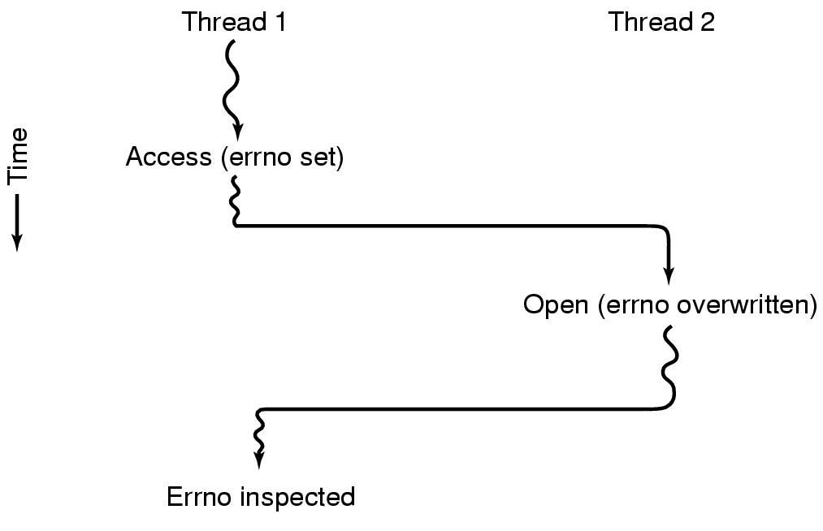
Making Single-Threaded Code Multithreaded (1)
Figure 2-19. Conflicts between threads
over the use of a global variable.
Tanenbaum, Modern Operating Systems 3 e, (c) 2008 Prentice-Hall, Inc. All rights reserved. 0-13-6006639

Slide 23
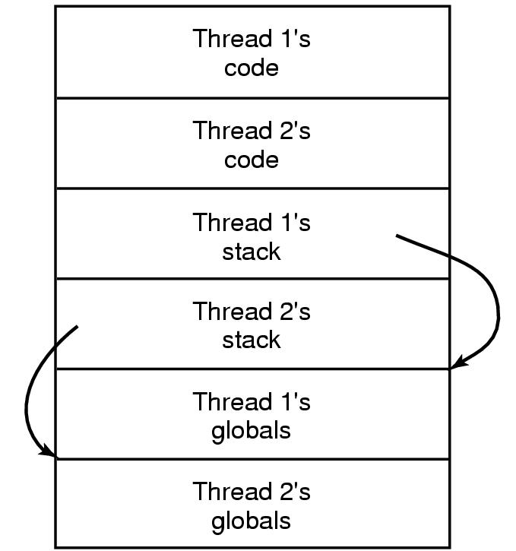
Making Single-Threaded Code Multithreaded (2)
Figure 2-20. Threads can have private global variables.
Tanenbaum, Modern Operating Systems 3 e, (c) 2008 Prentice-Hall, Inc. All rights reserved. 0-13-6006639

Slide 24
Problem: Race Conditions
Race Condition -Two or more processes want to modify a shared resource at the same time and the result depends upon who runs when.

Slide 25

Race Conditions
Figure 2-21. Two processes want to access shared memory at the same time.
Tanenbaum, Modern Operating Systems 3 e, (c) 2008 Prentice-Hall, Inc. All rights reserved. 0-13-6006639

Slide 26
Critical Regions (1)
Four conditions required to avoid race condition:
No two processes may be simultaneously inside their critical regions.
No assumptions may be made about speeds or the number of CPUs.
No process running outside its critical region may block other processes.
No process should have to wait forever to enter its critical region.
Tanenbaum, Modern Operating Systems 3 e, (c) 2008 Prentice-Hall, Inc. All rights reserved. 0-13-6006639

Slide 27

Critical Regions (2)
Figure 2-22. Mutual exclusion using critical regions.
Tanenbaum, Modern Operating Systems 3 e, (c) 2008 Prentice-Hall, Inc. All rights reserved. 0-13-6006639

Slide 28
Mutual Exclusion with Busy Waiting
Proposals for achieving mutual exclusion:
Disabling interrupts
Lock variables
Strict alternation
Peterson's solution
The TSL instruction
Tanenbaum, Modern Operating Systems 3 e, (c) 2008 Prentice-Hall, Inc. All rights reserved. 0-13-6006639

Slide 29
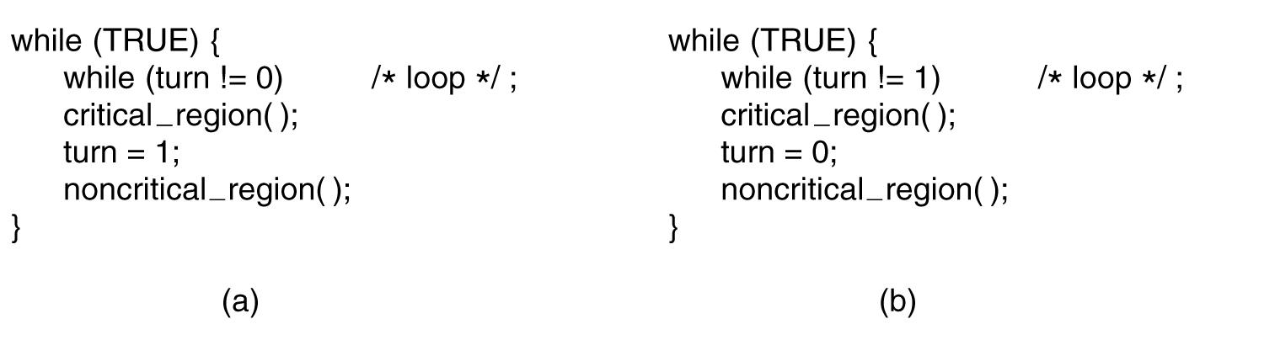
Strict Alternation
Figure 2-23. A proposed solution to the critical region problem.
(a) Process 0. (b) Process 1. In both cases, be sure to note the semicolons terminating the while statements.
Tanenbaum, Modern Operating Systems 3 e, (c) 2008 Prentice-Hall, Inc. All rights reserved. 0-13-6006639

Slide 30
INCORRECT Code for Mutual Exclusion (1)
// Version 1
int processnumber;
void processone() {
while (true) {
while (processnumber==2) /* NULL STATEMENT */ ;
criticalsection();
processnumber = 2;
otherstuff();
}
}
void processtwo() {
while (true) {
while (processnumber==1) /* NULL STATEMENT */ ;
criticalsection();
processnumber = 1;
otherstuff();
}
}
void main () {
processnumber = 1;
parallel {
processone();
processtwo();
}
}

Slide 31
INCORRECT Code for Mutual Exclusion (2)
// Version 2
bool p1inside, p2inside;
void processone() {
while (true) {
while (p2inside) /* NULL STATEMENT */ ;
p1inside = true;
criticalsection();
p1inside = false;
otherstuff();
}
}
void processtwo() {
while (true) {
while (p1inside) /* NULL STATEMENT */ ;
p2inside = true;
criticalsection();
p2inside = false;
otherstuff();
}
}
void main () {
p1inside = false;
p2inside = false;
parallel {
processone();
processtwo();
}
}

Slide 32
INCORRECT Code for Mutual Exclusion (3)
// Version 3
bool p1wantstoenter, p2wantstoenter;
void processone() {
while (true) {
p1wantstoenter = true;
while (p2wantstoenter) /* NULL STATEMENT */ ;
criticalsection();
p1wantstoenter = false;
otherstuff();
}
}
void processtwo() {
while (true) {
p2wantstoenter = true;
while (p1wantstoenter) /* NULL STATEMENT */ ;
criticalsection();
p2wantstoenter = false;
otherstuff();
}
}
void main () {
p1wantstoenter = false;
p2wantstoenter = false;
parallel {
processone();
processtwo();
}
}

Slide 33
INCORRECT Code for Mutual Exclusion (4)
// Version 4
bool p1wantstoenter, p2wantstoenter;
void processone() {
while (true) {
p1wantstoenter = true;
while (p2wantstoenter) {
p1wantstoenter = false;
wait(awhile);
p1wantstoenter = true;
}
criticalsection();
p1wantstoenter = false;
otherstuff();
}
}
void main () {
p1wantstoenter = false;
p2wantstoenter = false;
parallel {
processone();
processtwo();
}
}
void processtwo() {
while (true) {
p2wantstoenter = true;
while (p1wantstoenter) {
p2wantstoenter = false;
wait(awhile);
p1wantstoenter = true;
}
criticalsection();
p2wantstoenter = false;
otherstuff();
}
}

Slide 34
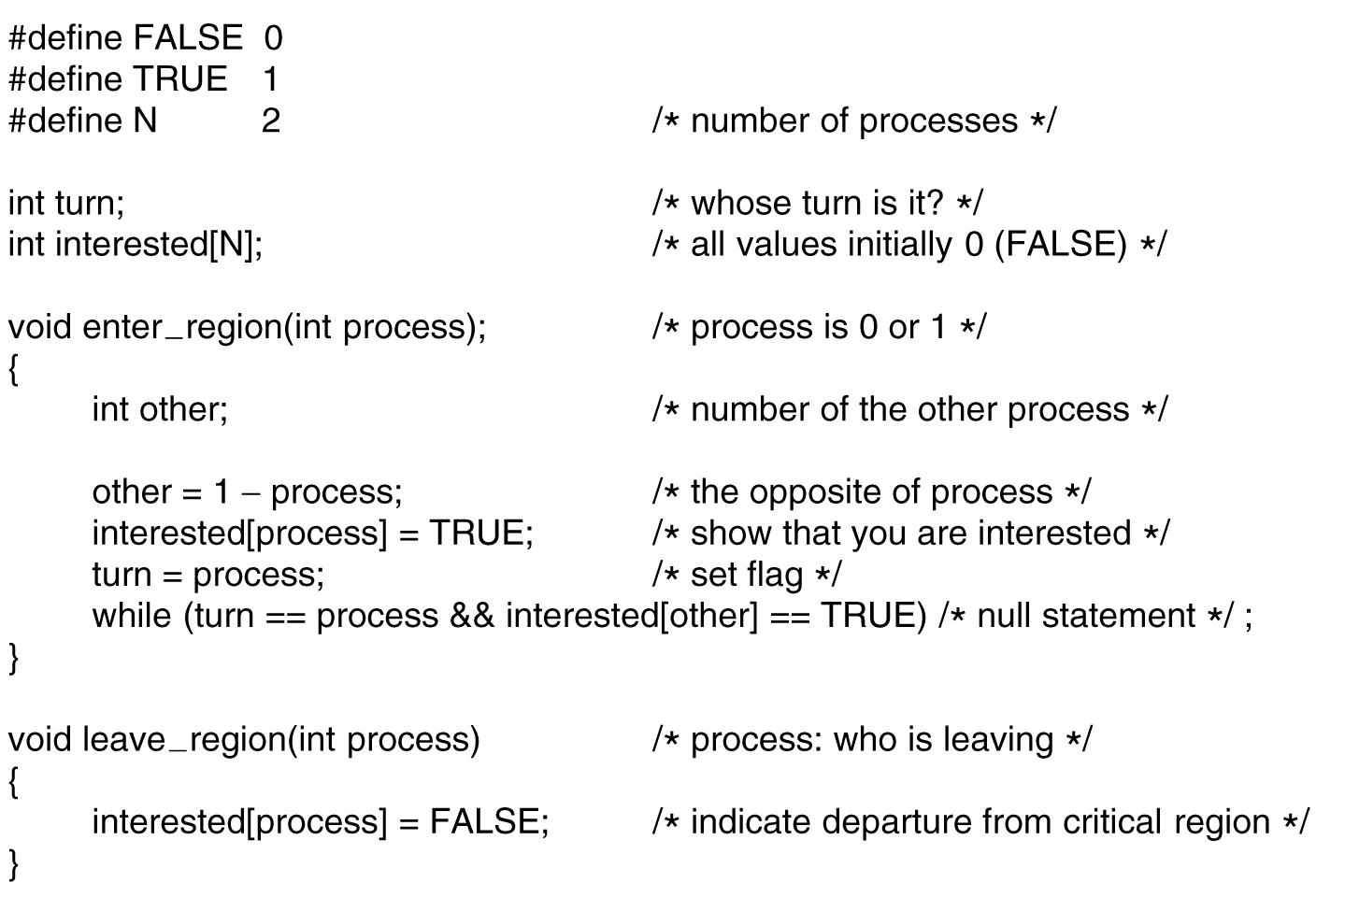
Peterson's Solution
Figure 2-24. Peterson’s solution for achieving mutual exclusion.
Tanenbaum, Modern Operating Systems 3 e, (c) 2008 Prentice-Hall, Inc. All rights reserved. 0-13-6006639

Slide 35
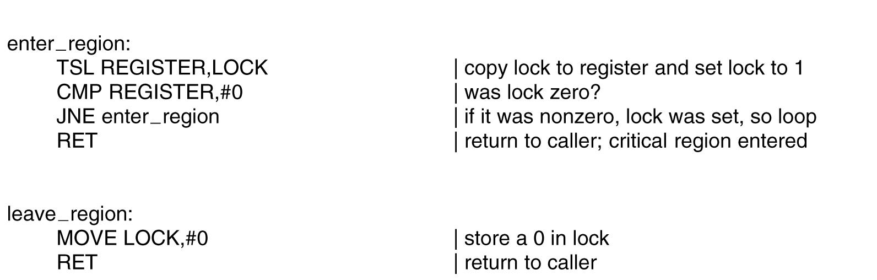
The TSL Instruction (1)
Figure 2-25. Entering and leaving a critical region
using the TSL instruction.
Tanenbaum, Modern Operating Systems 3 e, (c) 2008 Prentice-Hall, Inc. All rights reserved. 0-13-6006639

Slide 36
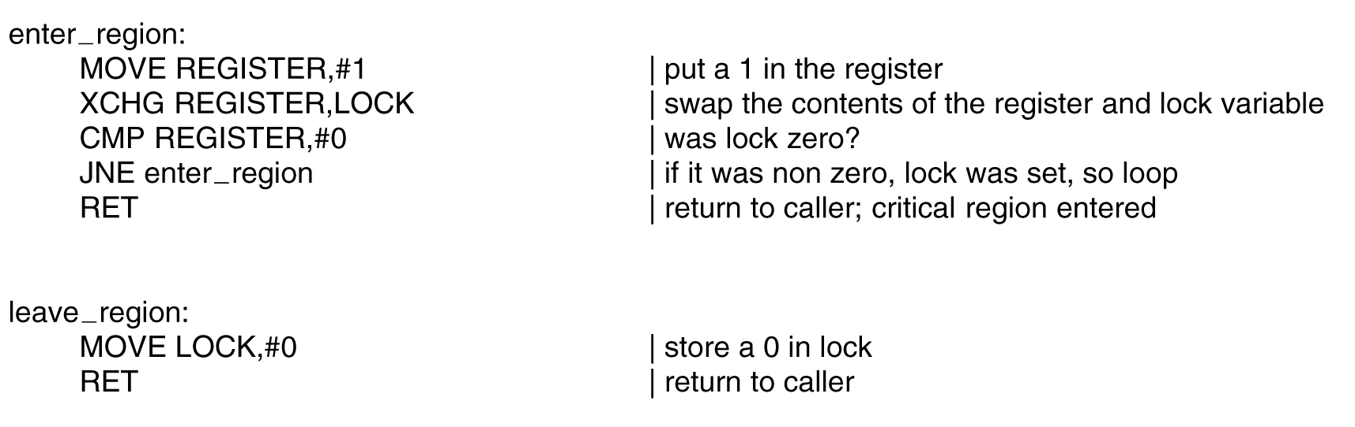
The TSL Instruction (2)
Figure 2-26. Entering and leaving a critical region
using the XCHG instruction.
Tanenbaum, Modern Operating Systems 3 e, (c) 2008 Prentice-Hall, Inc. All rights reserved. 0-13-6006639

Slide 37
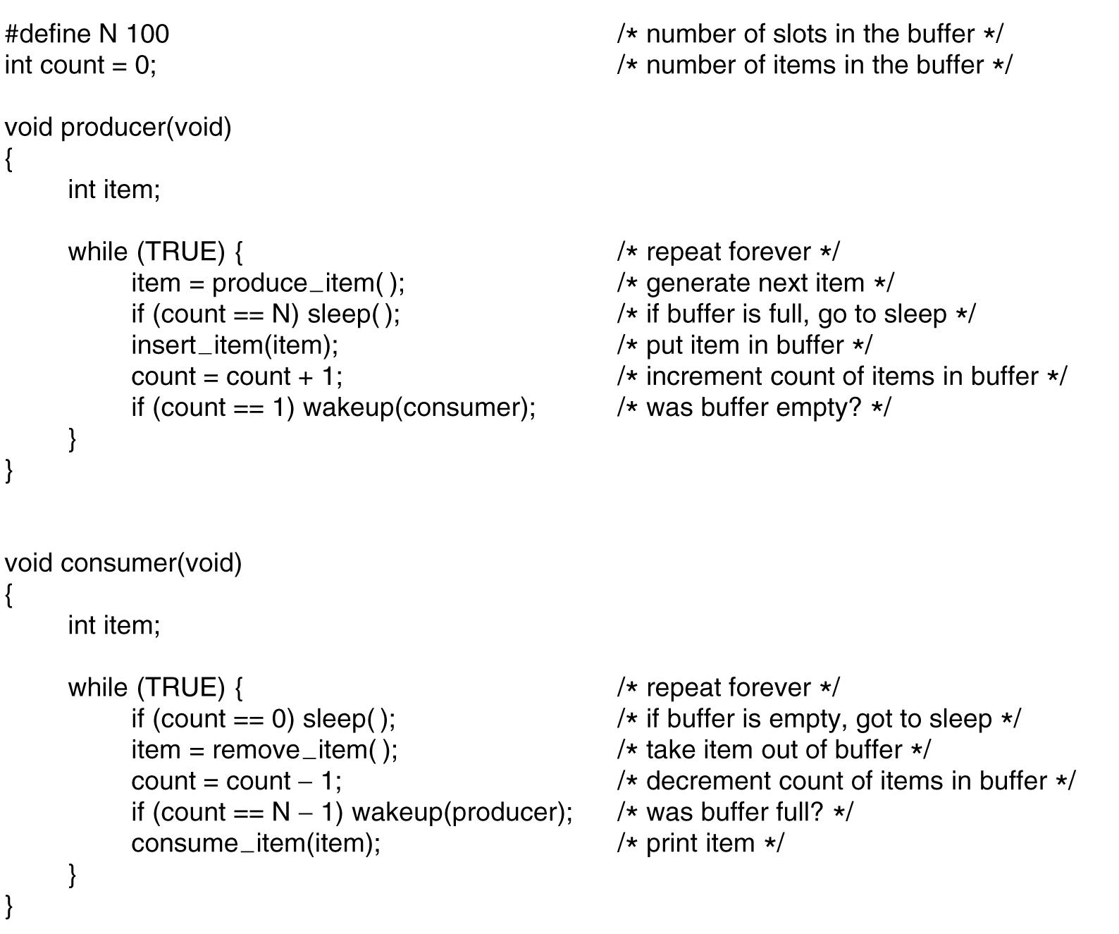
The Producer-Consumer Problem
. . .
Figure 2-27. The producer-consumer problem
with a fatal race condition.
Tanenbaum, Modern Operating Systems 3 e, (c) 2008 Prentice-Hall, Inc. All rights reserved. 0-13-6006639

Slide 38
Two Atomic Functions
down(s) { up(s) {
if (s > 0) if (1 or more processes waiting for s)
s--; pick_one_and_wake_it_up;
else else
go to sleep; s++;
} }
Atomic = Non-interruptible
These semaphore functions were proposed by E.W. Dijkstra in 1965.

Slide 39
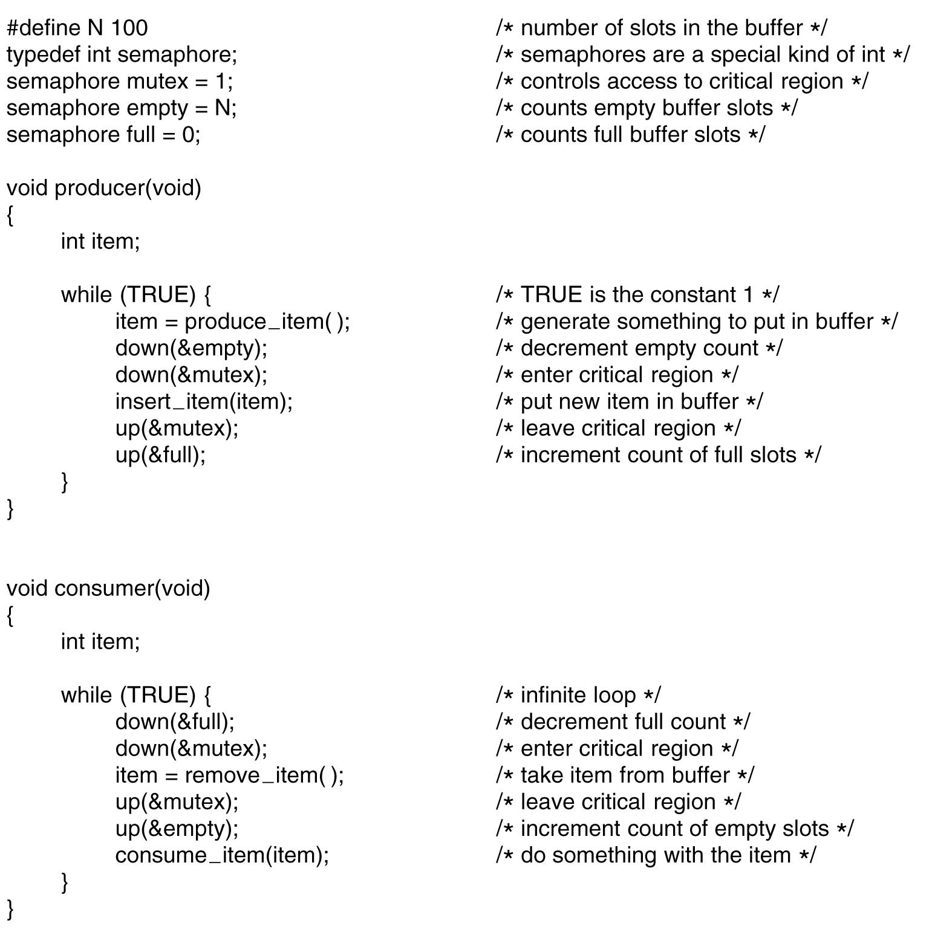
Semaphores
. . .
Figure 2-28. The producer-consumer problem using semaphores.
Tanenbaum, Modern Operating Systems 3 e, (c) 2008 Prentice-Hall, Inc. All rights reserved. 0-13-6006639

Slide 40
The Problem with Semaphores
#define N 100 /* number of slots in buffer */
typedef int semaphore /* semaphores are a special kind of int */
semaphore mutex = 1; /* controls access to critical region */
semaphore empty = N; /* counts empty buffer slots */
semaphore full = 0; /* counts full buffer slots */
void produce(void)
{
int item;
while (TRUE) { /* TRUE is the constant 1 */
item = produce_item(); /* generate something to put in buffer */
down(&mutex); /* enter critical region */
down(&empty); /* decrement empty count */
insert_item(item); /* put new item in buffer */
up(&mutex); /* leave critical region */
up(&full); /* increment count of full slots */
}
}
void consumer(void)
{
int item;
while (TRUE) { /* infinite loop */
down(&full); /* decrement full count */
down(&mutex); /* enter critical region */
item = remove_item(); /* take item from buffer */
up(&mutex); /* leave critical region */
up(&empty); /* increment count of empty slots */
consume_item(item); /* do something with the item */
}
}
It is EASY to make major programming errors!

Slide 41
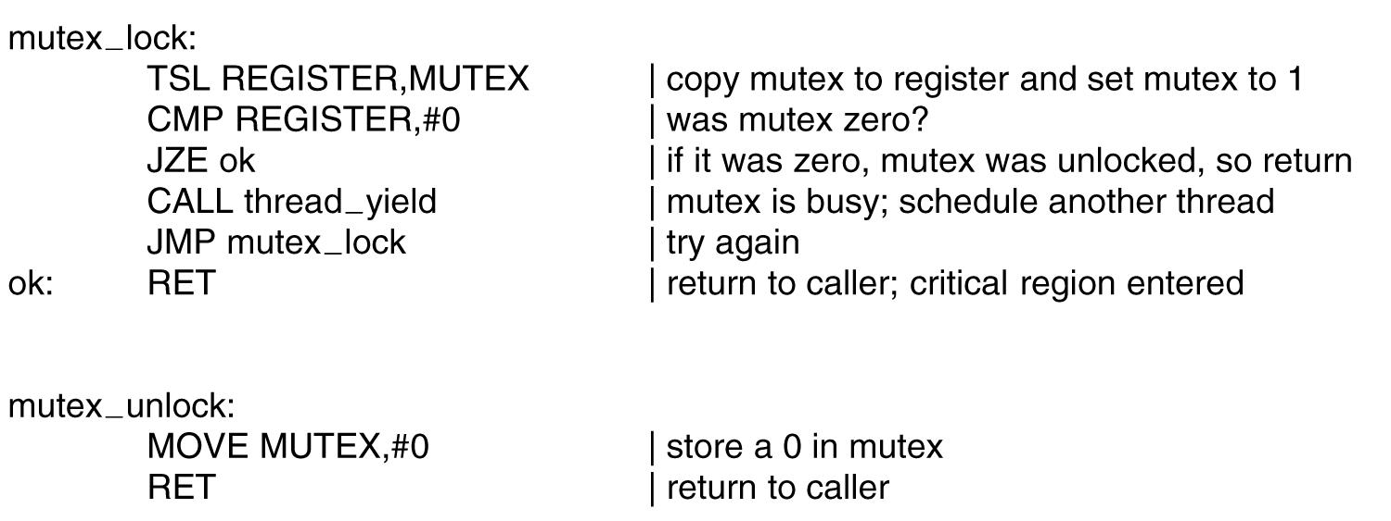
Mutexes
Figure 2-29. Implementation of mutex lock and mutex unlock.
Tanenbaum, Modern Operating Systems 3 e, (c) 2008 Prentice-Hall, Inc. All rights reserved. 0-13-6006639

Slide 42
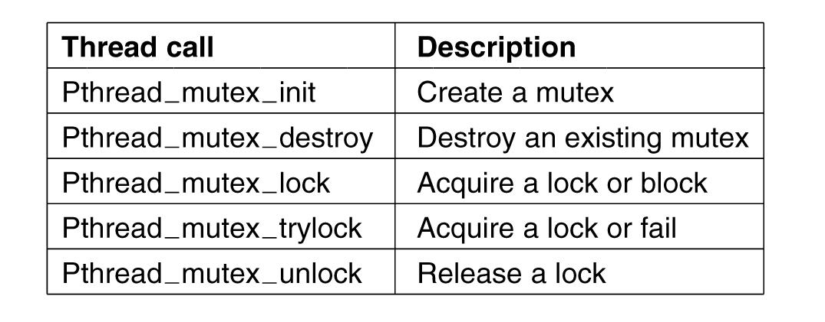
Mutexes in Pthreads (1)
Figure 2-30. Some of the Pthreads calls relating to mutexes.
Tanenbaum, Modern Operating Systems 3 e, (c) 2008 Prentice-Hall, Inc. All rights reserved. 0-13-6006639

Slide 43
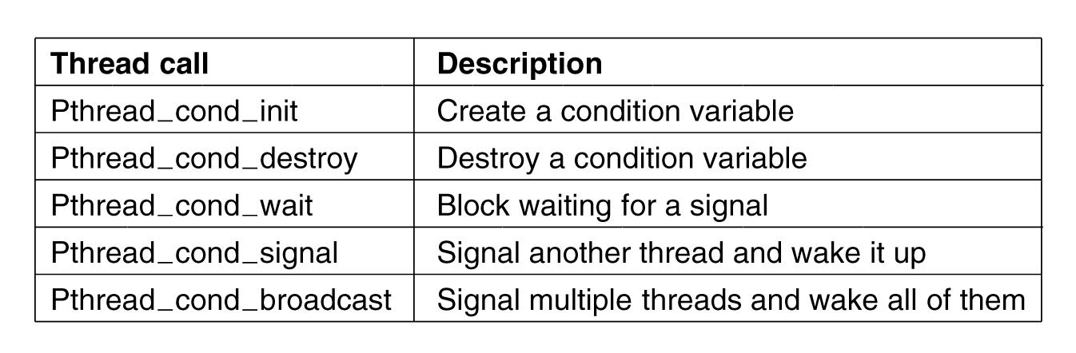
Mutexes in Pthreads (2)
Figure 2-31. Some of the Pthreads calls relating
to condition variables.
Tanenbaum, Modern Operating Systems 3 e, (c) 2008 Prentice-Hall, Inc. All rights reserved. 0-13-6006639

Slide 44
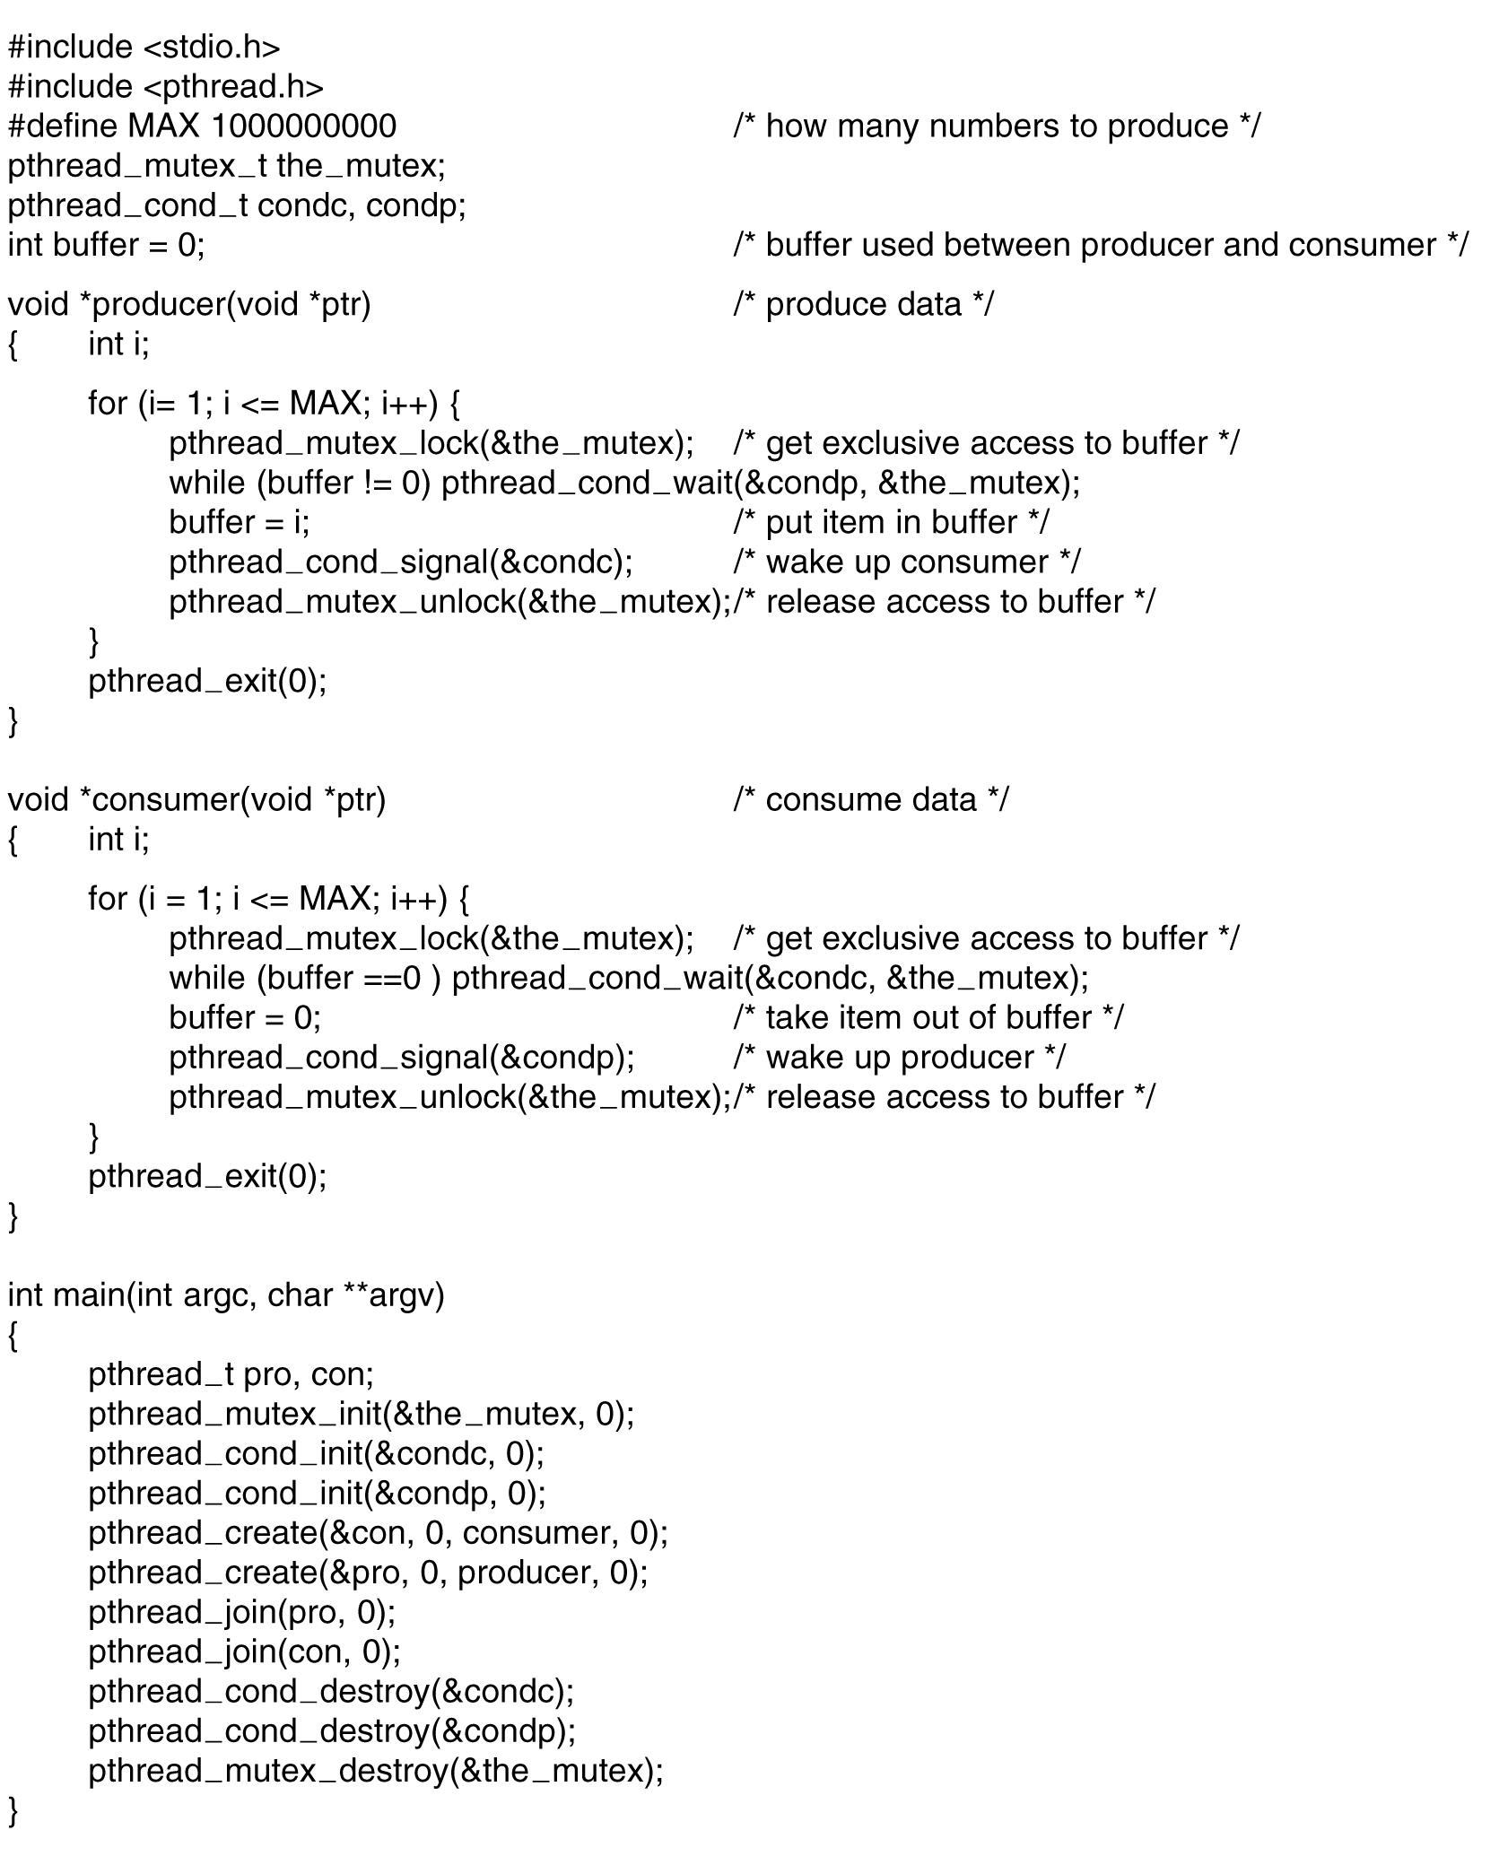
Mutexes in Pthreads (3)
. . .
Figure 2-32. Using threads to solve
the producer-consumer problem.
Tanenbaum, Modern Operating Systems 3 e, (c) 2008 Prentice-Hall, Inc. All rights reserved. 0-13-6006639

Slide 45
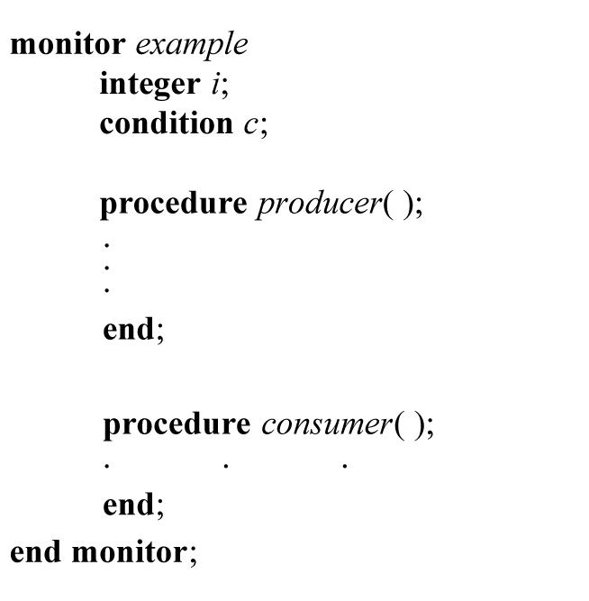
Monitors (1)
Figure 2-33. A monitor.
Tanenbaum, Modern Operating Systems 3 e, (c) 2008 Prentice-Hall, Inc. All rights reserved. 0-13-6006639

Slide 46
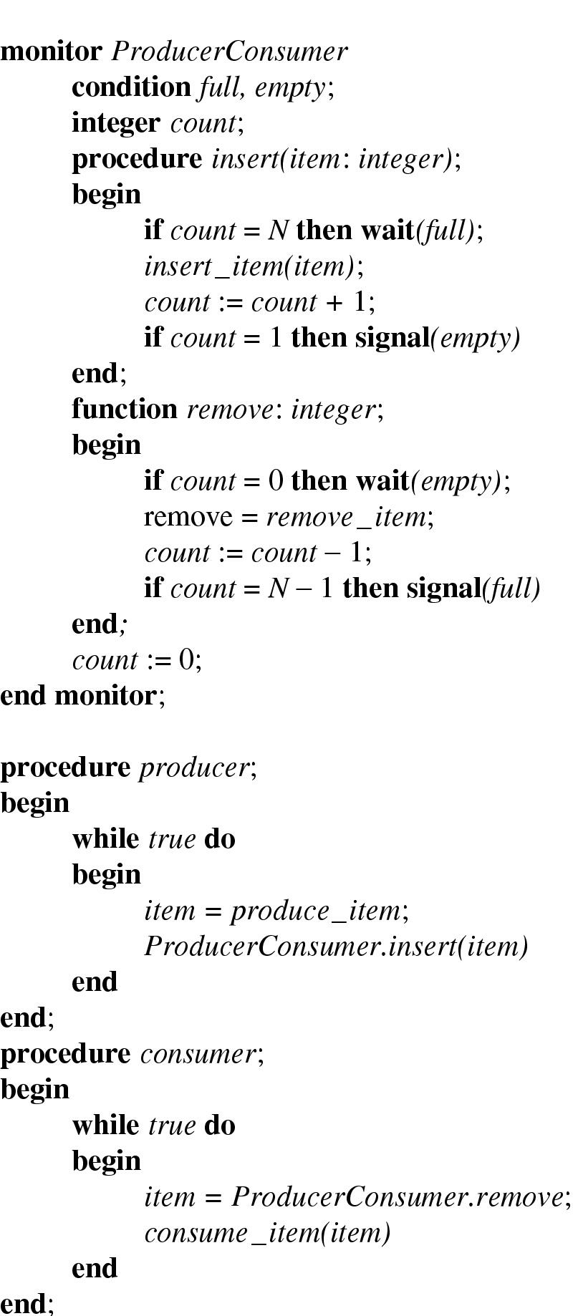
Monitors (2)
Outline of producer-consumer problem with monitors
  only one monitor procedure active at one time
  buffer has N slots

Slide 47
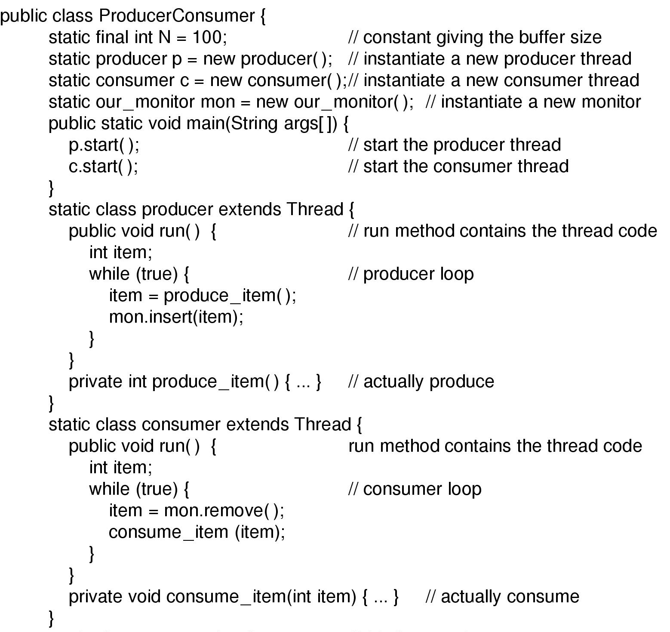
Monitors (3)
Solution to producer-consumer problem in Java (part 1)

Slide 48
Monitors (4)
Static class our_monitor { // this is a monitor
private int buffer[] = new int[N];
private int count = 0, lo = 0, hi = 0; // counters and indices
public synchronized void insert(int val) {
if (count == N) go_to_sleep(); // if the buffer is full, go to sleep
buffer[hi] = val; // insert an item into the buffer
hi = (hi + 1) % N; // slot to place next item in
count = count + 1; // one more item in the buffer now
if (count == 1) notify(); // if consumer was sleeping, wake it up.
}
public synchronized int remove() {
int val;
if (count == 0) go_to_sleep(); // if the buffer is empty, go to sleep
val = buffer[lo]; // fetch an item from the buffer
lo = (lo + 1) % N; // slot to fetch next item from
count = count – 1; // one less item in the buffer
if (count == N-1) notify(); // if producer was sleeping, wake it up.
return val;
}
private void go_to_sleep() {
try{wait();} catch(InterruptedExecption exc) {};
}
}
Solution to producer-consumer problem in Java (part 2)

Slide 49
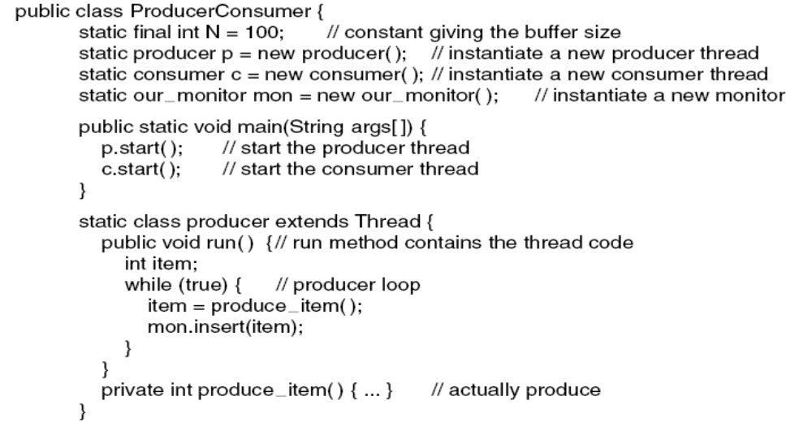
Message Passing (1)
. . .
Figure 2-35. A solution to the producer-consumer
problem in Java.
Tanenbaum, Modern Operating Systems 3 e, (c) 2008 Prentice-Hall, Inc. All rights reserved. 0-13-6006639

Slide 50
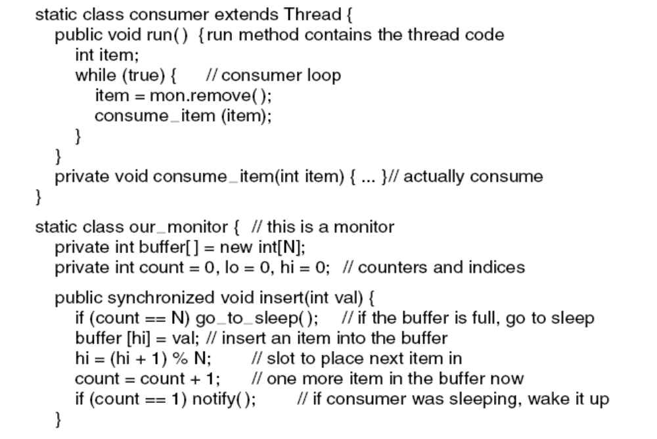
Message Passing (2)
. . .
. . .
Figure 2-35. A solution to the producer-consumer
problem in Java.
Tanenbaum, Modern Operating Systems 3 e, (c) 2008 Prentice-Hall, Inc. All rights reserved. 0-13-6006639

Slide 51
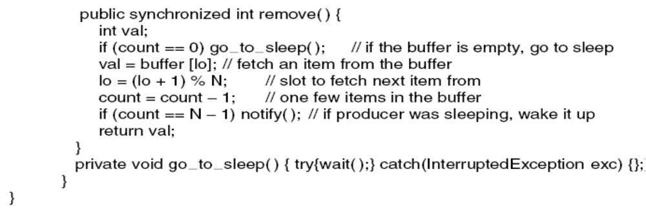
Message Passing (3)
. . .
Figure 2-35. A solution to the producer-consumer
problem in Java.
Tanenbaum, Modern Operating Systems 3 e, (c) 2008 Prentice-Hall, Inc. All rights reserved. 0-13-6006639

Slide 52
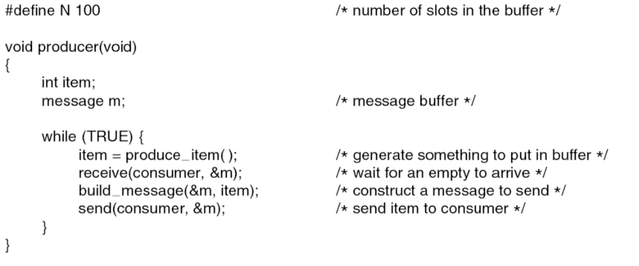
Producer-Consumer Problem
with Message Passing (1)
. . .
Figure 2-36. The producer-consumer problem with N messages.
Tanenbaum, Modern Operating Systems 3 e, (c) 2008 Prentice-Hall, Inc. All rights reserved. 0-13-6006639

Slide 53
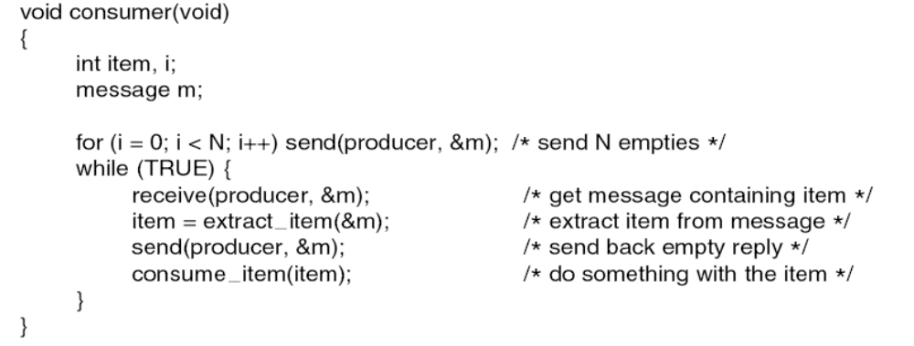
Producer-Consumer Problem
with Message Passing (2)
. . .
Figure 2-36. The producer-consumer problem with N messages.
Tanenbaum, Modern Operating Systems 3 e, (c) 2008 Prentice-Hall, Inc. All rights reserved. 0-13-6006639

Slide 54
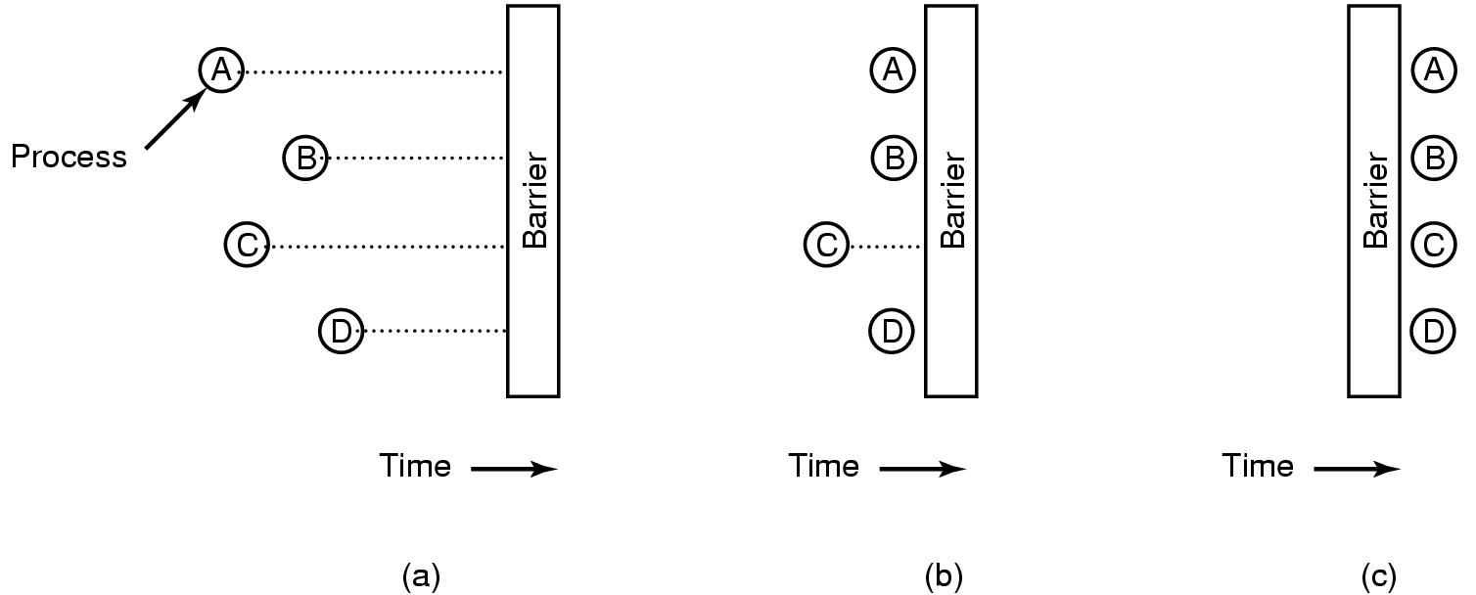
Barriers
Figure 2-37. Use of a barrier. (a) Processes approaching a barrier. (b) All processes but one blocked at the barrier. (c) When the last process arrives at the barrier, all of them are let through.
Tanenbaum, Modern Operating Systems 3 e, (c) 2008 Prentice-Hall, Inc. All rights reserved. 0-13-6006639

Slide 55
Scheduling Algorithms

Slide 56

Scheduling – Process Behavior
Figure 2-38. Bursts of CPU usage alternate with periods of waiting for I/O. (a) A CPU-bound process. (b) An I/O-bound process.
Tanenbaum, Modern Operating Systems 3 e, (c) 2008 Prentice-Hall, Inc. All rights reserved. 0-13-6006639

Slide 57
Categories of Scheduling Algorithms
Batch
Interactive
Real time
Tanenbaum, Modern Operating Systems 3 e, (c) 2008 Prentice-Hall, Inc. All rights reserved. 0-13-6006639

Slide 58
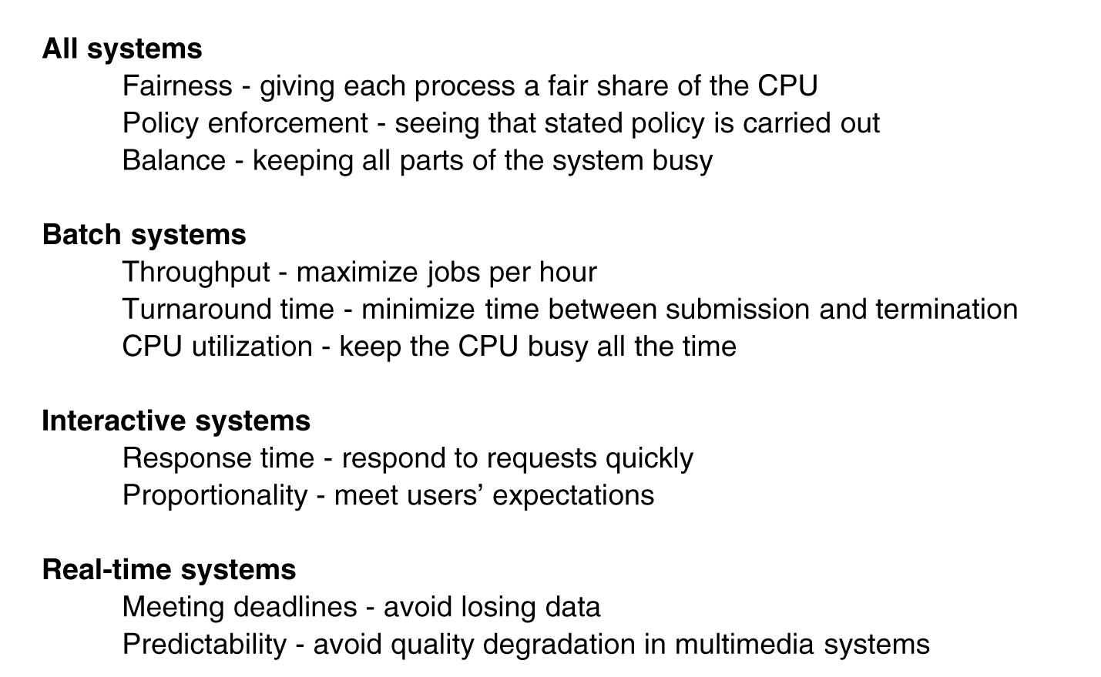
Scheduling Algorithm Goals
Figure 2-39. Some goals of the scheduling algorithm under different circumstances.
Tanenbaum, Modern Operating Systems 3 e, (c) 2008 Prentice-Hall, Inc. All rights reserved. 0-13-6006639

Slide 59
Scheduling in Batch Systems
First-come first-served
Shortest job first
Shortest remaining Time next
Tanenbaum, Modern Operating Systems 3 e, (c) 2008 Prentice-Hall, Inc. All rights reserved. 0-13-6006639

Slide 60
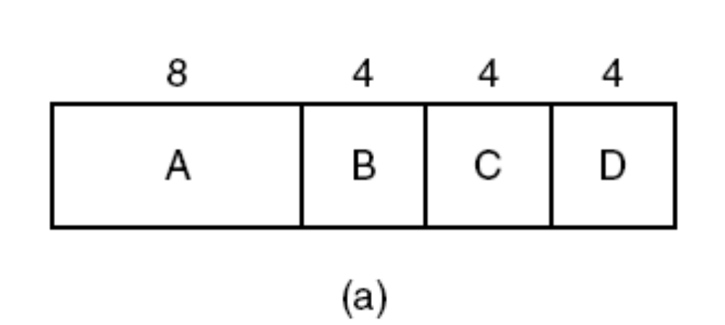
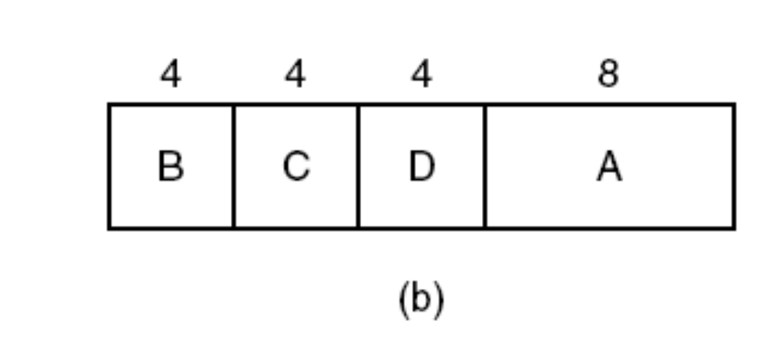
Shortest Job First
Figure 2-40. An example of shortest job first scheduling.
(a) Running four jobs in the original order. (b) Running them in shortest job first order.
Tanenbaum, Modern Operating Systems 3 e, (c) 2008 Prentice-Hall, Inc. All rights reserved. 0-13-6006639

Slide 61
Scheduling in Interactive Systems
Round-robin scheduling
Priority scheduling
Multiple queues
Shortest process next
Guaranteed scheduling
Lottery scheduling
Fair-share scheduling
Tanenbaum, Modern Operating Systems 3 e, (c) 2008 Prentice-Hall, Inc. All rights reserved. 0-13-6006639

Slide 62
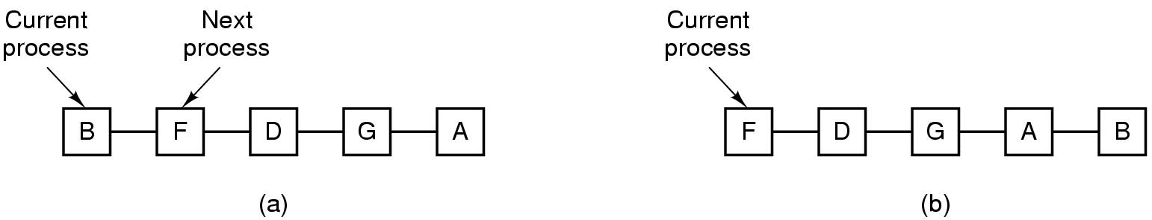
Round-Robin Scheduling
Figure 2-41. Round-robin scheduling.
(a) The list of runnable processes. (b) The list of runnable processes after B uses up its quantum.
Tanenbaum, Modern Operating Systems 3 e, (c) 2008 Prentice-Hall, Inc. All rights reserved. 0-13-6006639

Slide 63
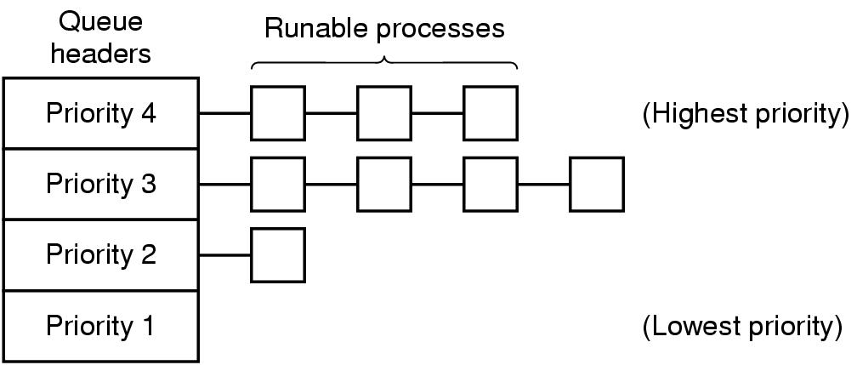
Priority Scheduling
Figure 2-42. A scheduling algorithm with four priority classes.
Tanenbaum, Modern Operating Systems 3 e, (c) 2008 Prentice-Hall, Inc. All rights reserved. 0-13-6006639

Slide 64
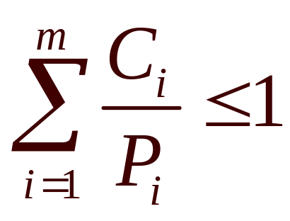
Scheduling in Real-Time Systems
Schedulable real-time system
Given
  m periodic events
  event i occurs within period P_{i} and requires C_{i} seconds
Then the load can only be handled if

Slide 65
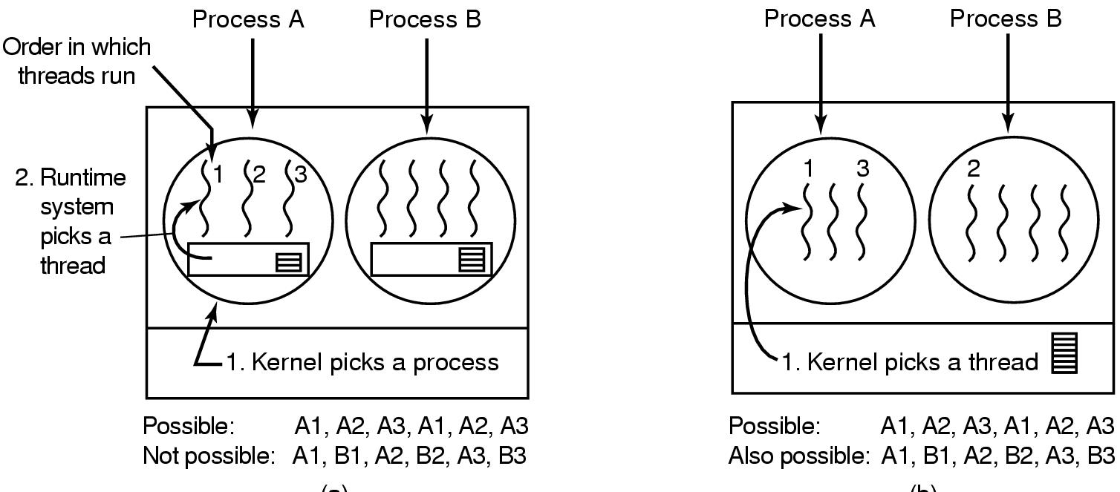
Thread Scheduling (1)
Figure 2-43. (a) Possible scheduling of user-level threads with a 50-msec process quantum and threads that run 5 msec per CPU burst.
Tanenbaum, Modern Operating Systems 3 e, (c) 2008 Prentice-Hall, Inc. All rights reserved. 0-13-6006639

Slide 66
Thread Scheduling (2)
Figure 2-43. (b) Possible scheduling of kernel-level threads with the same characteristics as (a).
Tanenbaum, Modern Operating Systems 3 e, (c) 2008 Prentice-Hall, Inc. All rights reserved. 0-13-6006639

Slide 67
Classic Problems

Slide 68

Dining Philosophers Problem (1)
Figure 2-44. Lunch time in the Philosophy Department.
Tanenbaum, Modern Operating Systems 3 e, (c) 2008 Prentice-Hall, Inc. All rights reserved. 0-13-6006639

Slide 69
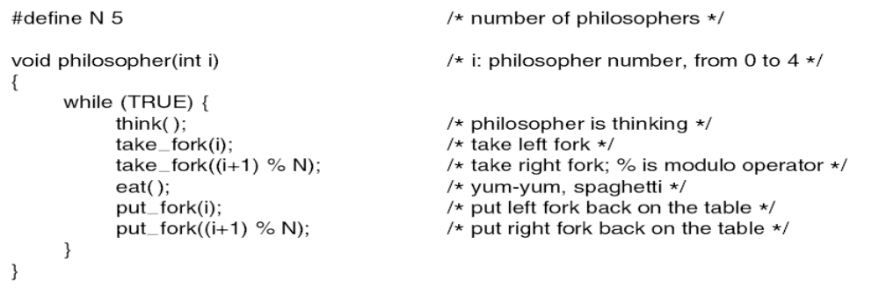
Dining Philosophers Problem (2)
Figure 2-45. A nonsolution to the dining philosophers problem.
Tanenbaum, Modern Operating Systems 3 e, (c) 2008 Prentice-Hall, Inc. All rights reserved. 0-13-6006639

Slide 70
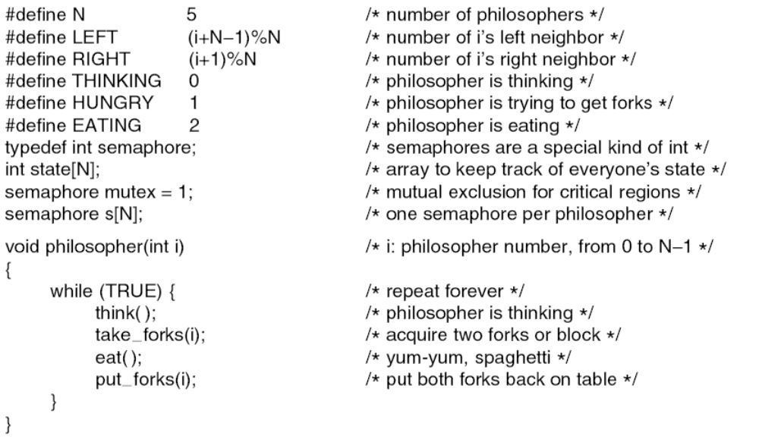
Dining Philosophers Problem (3)
. . .
Figure 2-46. A solution to the dining philosophers problem.
Tanenbaum, Modern Operating Systems 3 e, (c) 2008 Prentice-Hall, Inc. All rights reserved. 0-13-6006639

Slide 71
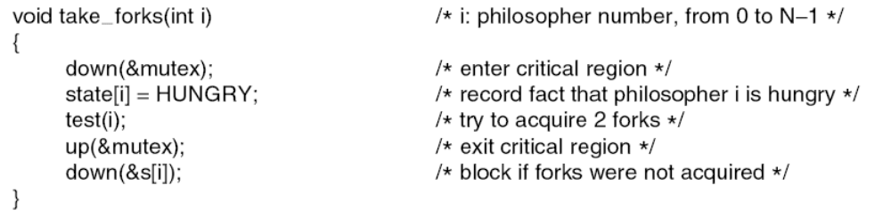
Dining Philosophers Problem (4)
. . .
. . .
Figure 2-46. A solution to the dining philosophers problem.
Tanenbaum, Modern Operating Systems 3 e, (c) 2008 Prentice-Hall, Inc. All rights reserved. 0-13-6006639

Slide 72
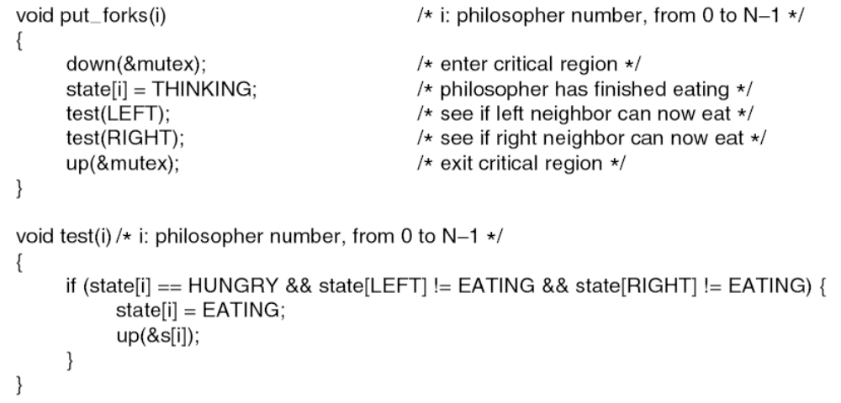
Dining Philosophers Problem (5)
. . .
Figure 2-46. A solution to the dining philosophers problem.
Tanenbaum, Modern Operating Systems 3 e, (c) 2008 Prentice-Hall, Inc. All rights reserved. 0-13-6006639

Slide 73
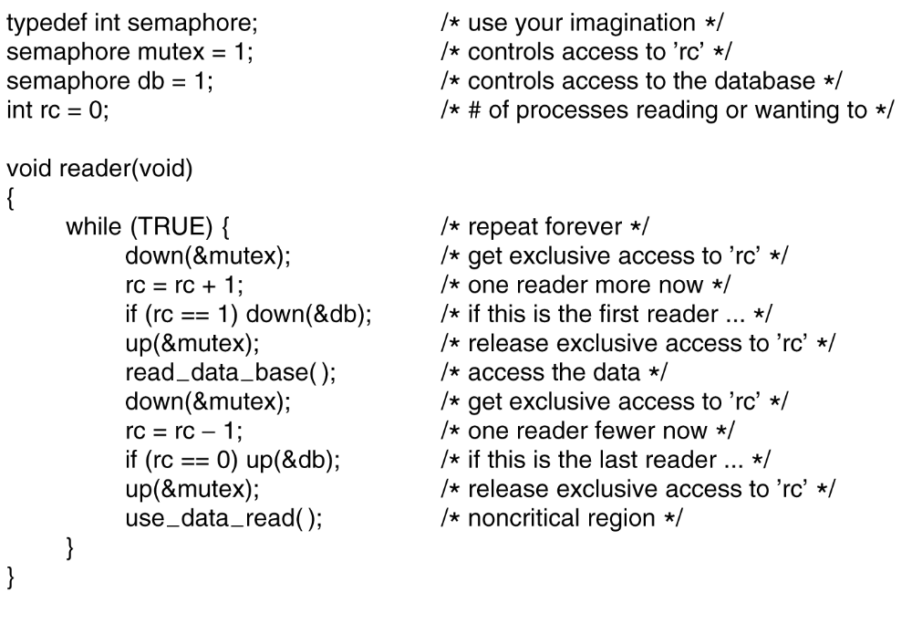
The Readers and Writers Problem (1)
. . .
Figure 2-47. A solution to the readers and writers problem.
Tanenbaum, Modern Operating Systems 3 e, (c) 2008 Prentice-Hall, Inc. All rights reserved. 0-13-6006639

Slide 74
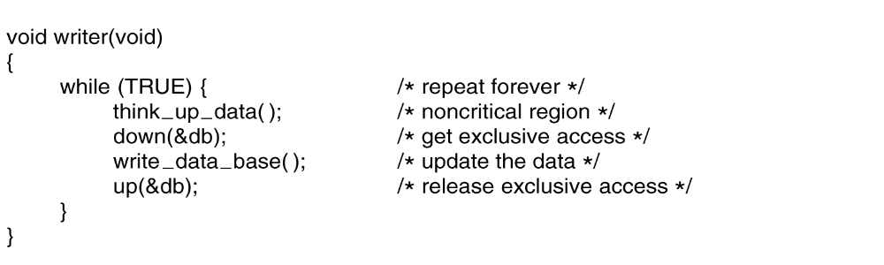
The Readers and Writers Problem (2)
. . .
Figure 2-47. A solution to the readers and writers problem.
Tanenbaum, Modern Operating Systems 3 e, (c) 2008 Prentice-Hall, Inc. All rights reserved. 0-13-6006639

